Slide 1
FEDERAL POLYTECHNIC EDE
eClassroom

Slide 2
Introduction
FPE eClassroom is a blended Learning and Classroom Management software application designed for android based mobile phones and smart devices that provides the framework that handles all aspect of the learning process.

Slide 3
Objectives
Objectives of FPE eClassroom are to:
Host and track online learning by providing virtual hub where learners can have access to training / learning resources
Enhance the quality of learning and teaching by meeting the learning styles or the needs of the students
Make training accessible for remote learners and provide a central location for training across the institution
Improve user-accessibility and time flexibility to engage learners in the learning process

Slide 4
Features
Management of lecture materials
Group Chat Real-time interactivity
Administration of Computer-Based Tests on mobile devices
Managing allocation of Monthly Data Requests for Lecturers e. Classroom Controls and Notifications

Slide 5
Accessibility/Download
FPE eClassroom is accessible on google play store and can be downloaded by lecturers and students

Slide 6
Lecturers Activities
Lecturers are required to login to FPE eClassroom using the same FPE SIMS login credentials
Register Semester Courses
Prepare and upload Course Information, Course Outlines and Courseware for the semester courses
Engage students in learning using the Real-time Group Chat rooms
Conduct CBT / Quizzes for continuous assessments

Slide 7
Students Activities
Students are required to login to FPE eClassroom using the same Portal login credentials
Download Courseware for all the registered semester courses
Join the Lecturers in learning using the Real-time Group Chat rooms
Prepare for continuous assessments with CBT

Slide 8
User’s Interface Description

Slide 9
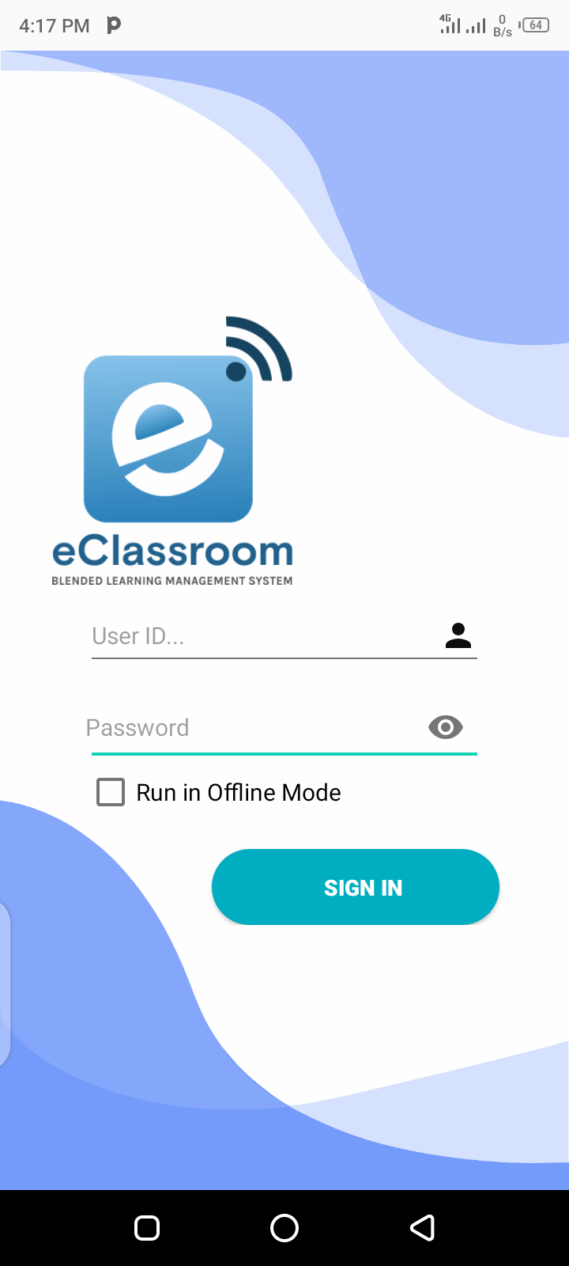
Login Page
Enter your User ID and Password here to gain access.

Slide 10
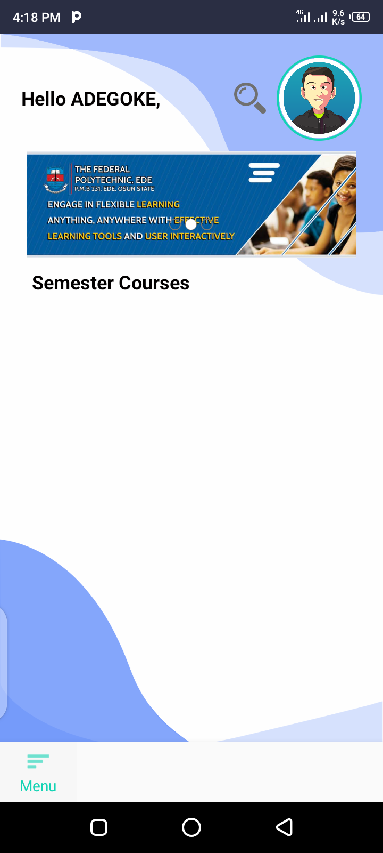
Lecturer’s Dashbaord
All registered courses are listed here
This pops-up the menu list

Slide 11
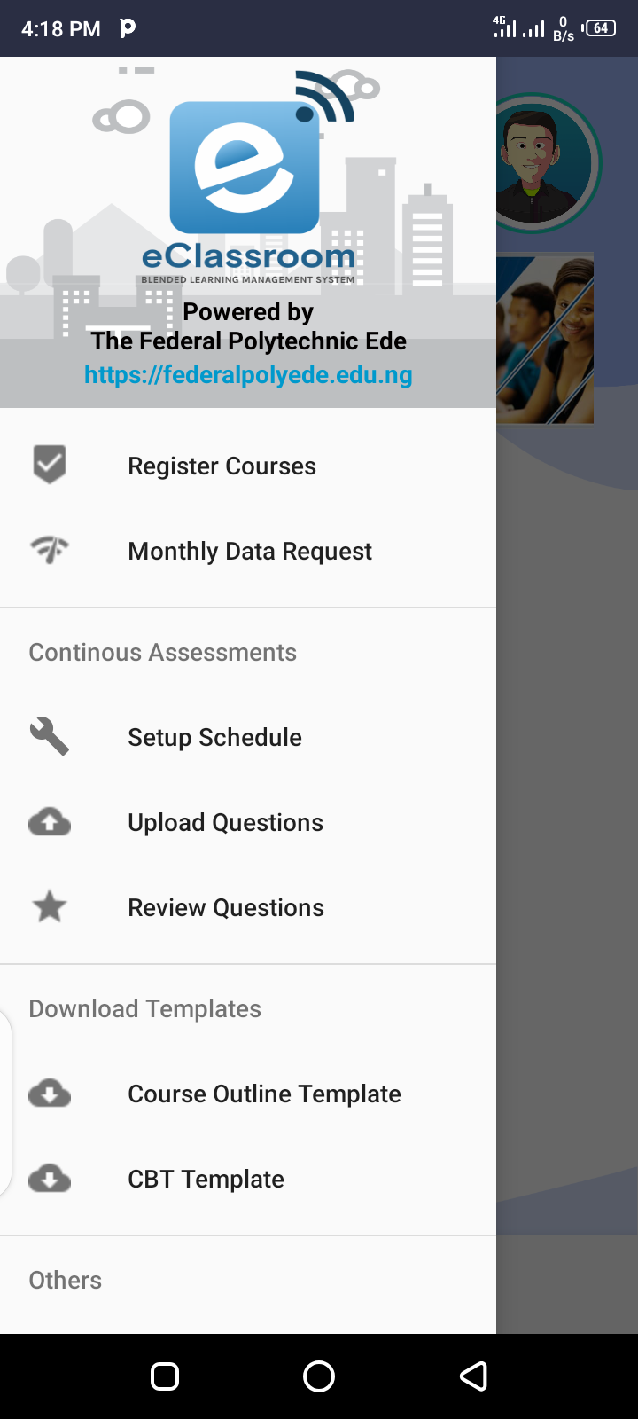
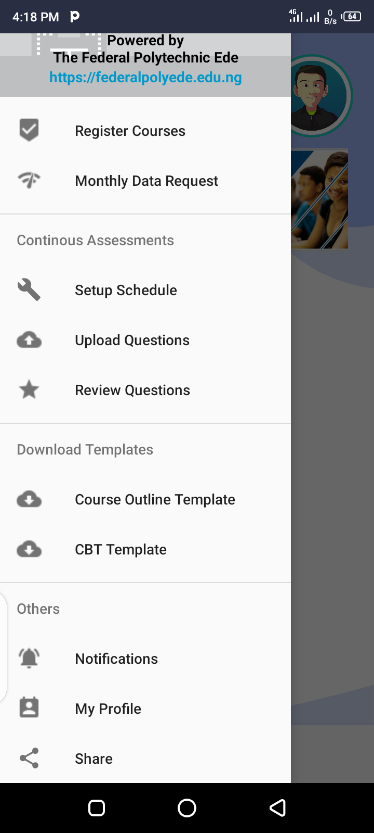
Menu List

Slide 12
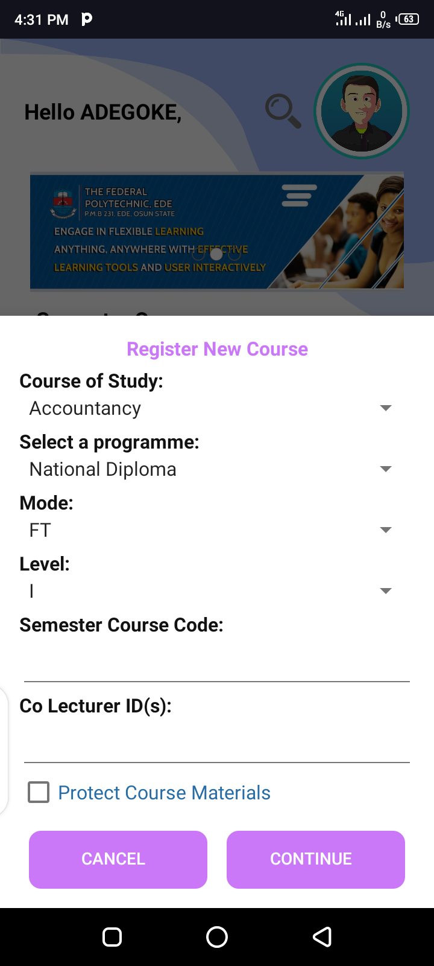
Menu List: Register Courses
This function allows a Lecturer/Technologist to protect his/her intellectual material. It can only be viewed but cannot be downloaded.

Slide 13
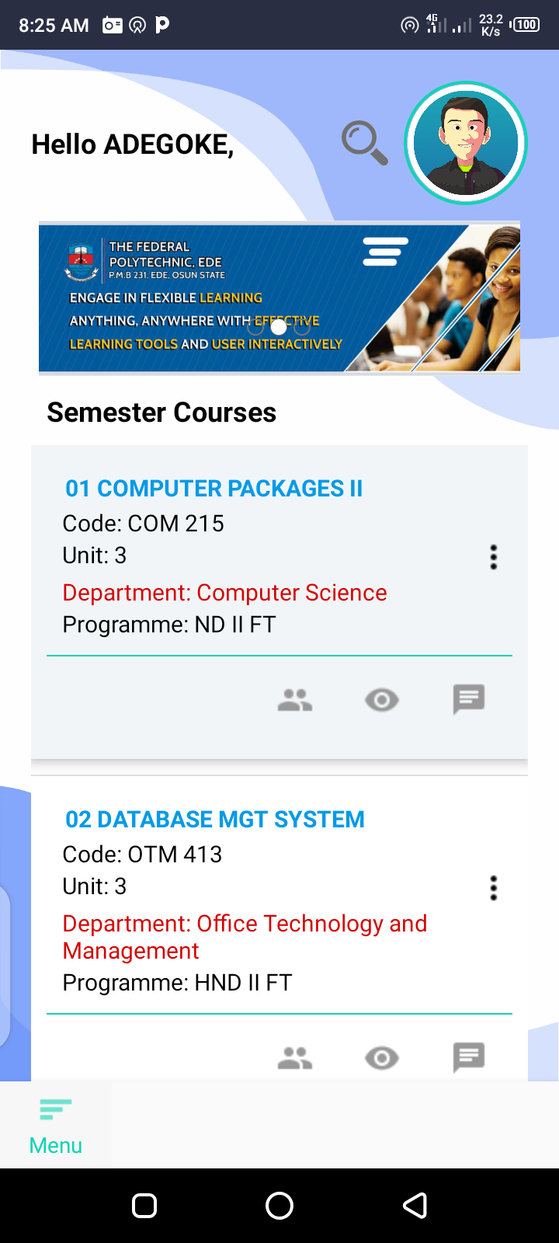
Menu List: Registered Courses on Dashboard
Displays available options, demonstrated in the next slide
1
Displays list of students enrollment for the course
2
Attendance register allows a tutor to check list of students who attended the class
3
This icon represent discussion/chat room. To be explained in further slides
4

Slide 14
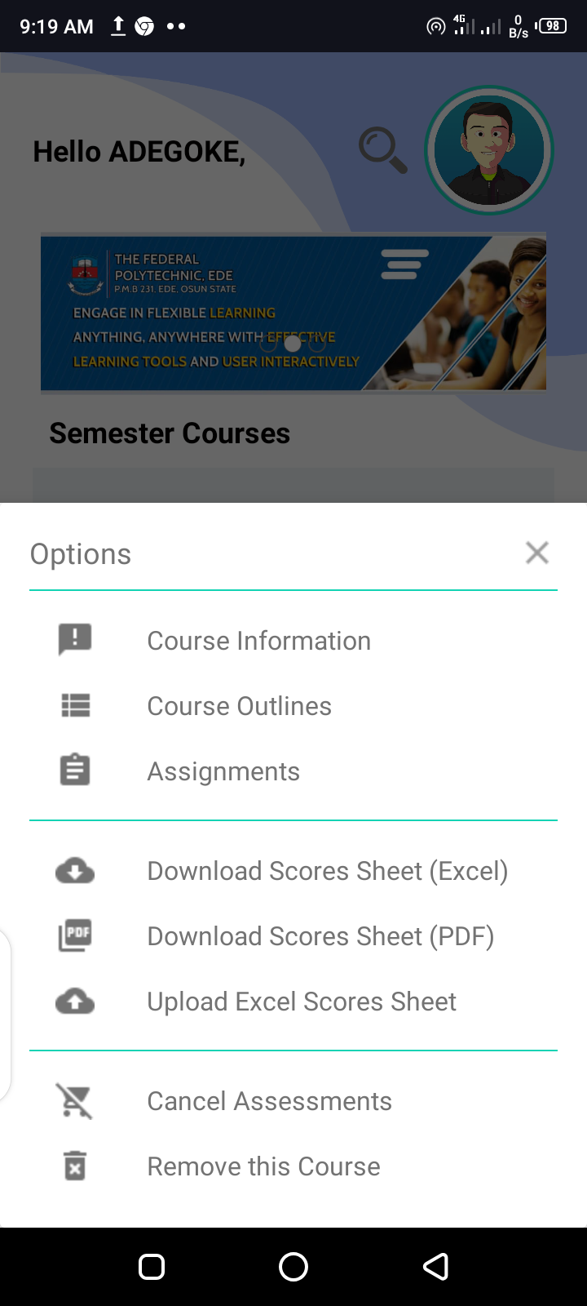
Menu List: Registered Courses on Dashboard
Allows you to “View” or “Upload” course information.
1
Allows you to “View” or “Upload” course outlines.
Allows you to “View” or “Upload” assignments
Enables tutor to download score sheet (Excel)
Enables tutor to download score sheet (PDF)
Enables tutor to upload score sheet (Excel)
Cancels already scheduled assignments
Used to remove registered courses

Slide 15
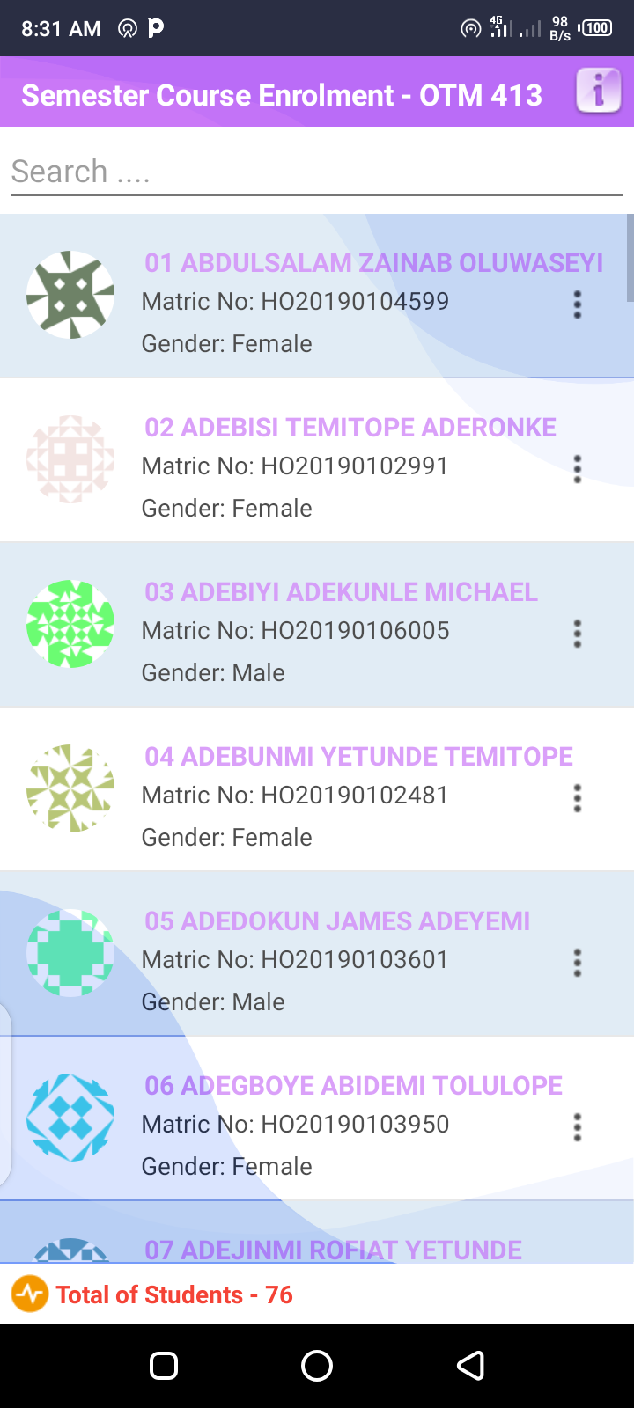
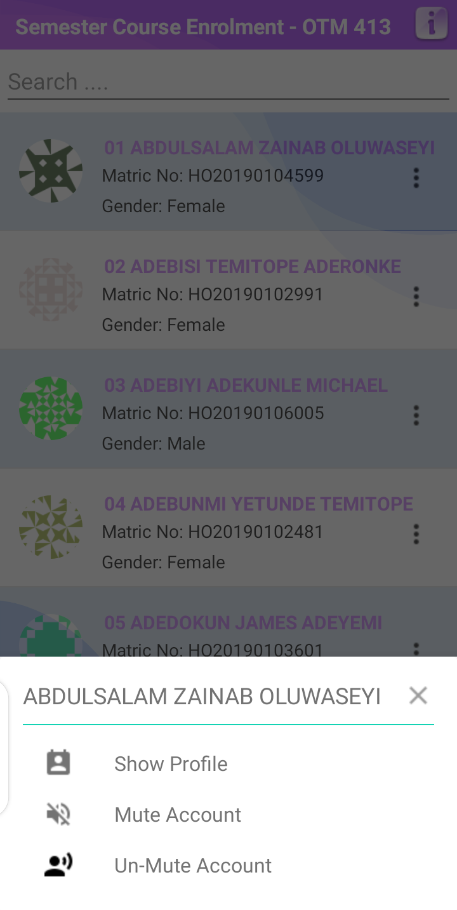
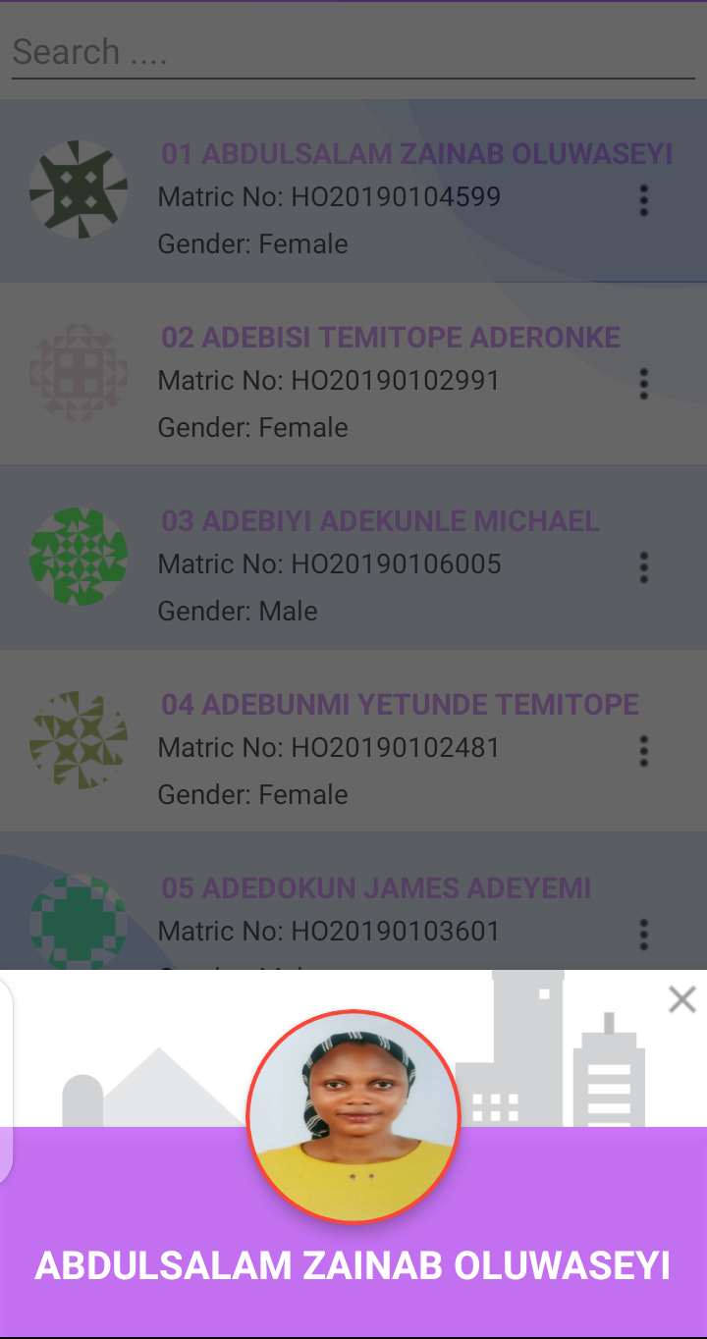
Semester Courses Enrolment
2
Displays student profile
Used to mute/unmute student account

Slide 16
Semester Courses Enrolment… Contd.
Allows you search for student information by keywords
Displays total number of registered students for the course

Slide 17
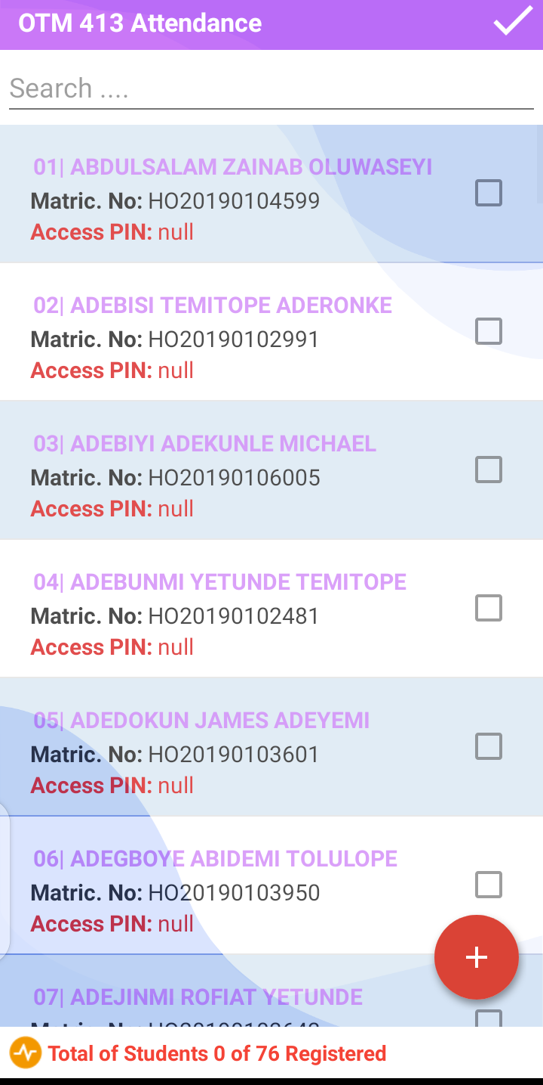
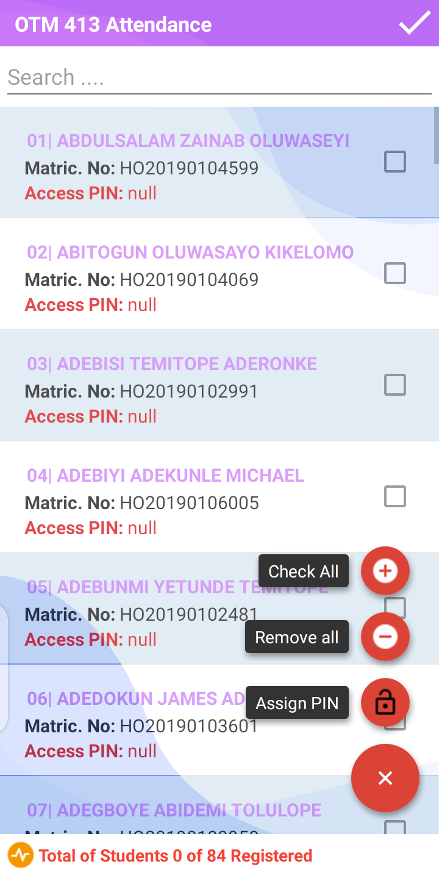
Menu List: Registered Courses on Dashboard (Attendance List)
To check all attendees
3
To uncheck all attendees
To assign access ‘PIN’
Which is randomly generated
Minimizes functionalities
Functionalities

Slide 18
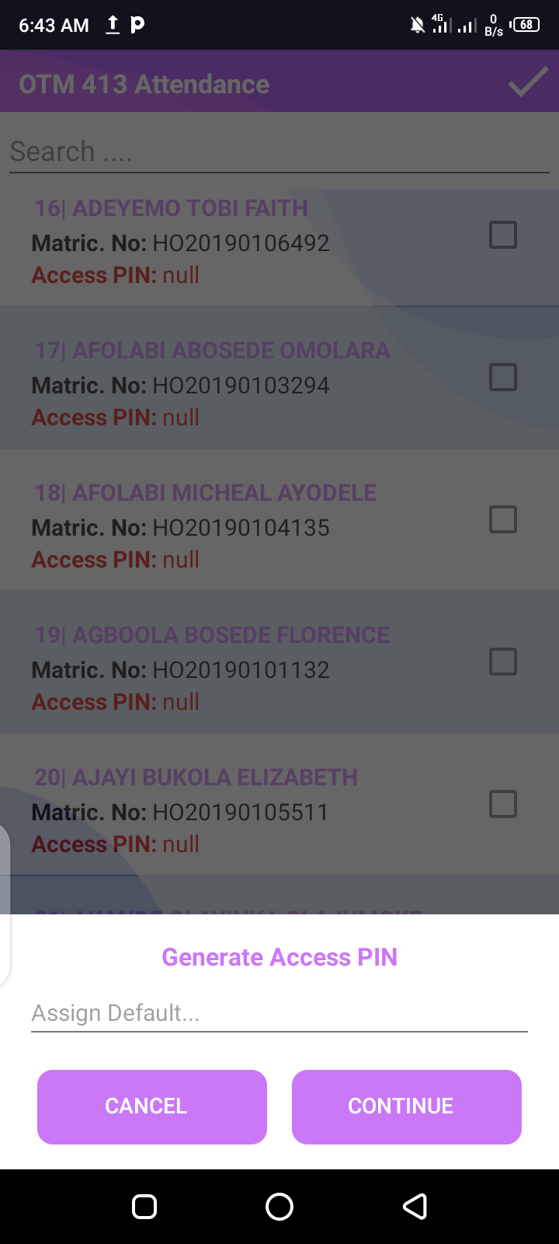
Menu List: Registered Courses on Dashboard (Attendance List): Assign PIN
To randomly generate access PIN (Check attendees list and click continue) and reload list.
BUT
To assign same PIN for all, type the assigned PIN desired, click continue and reload

Slide 19
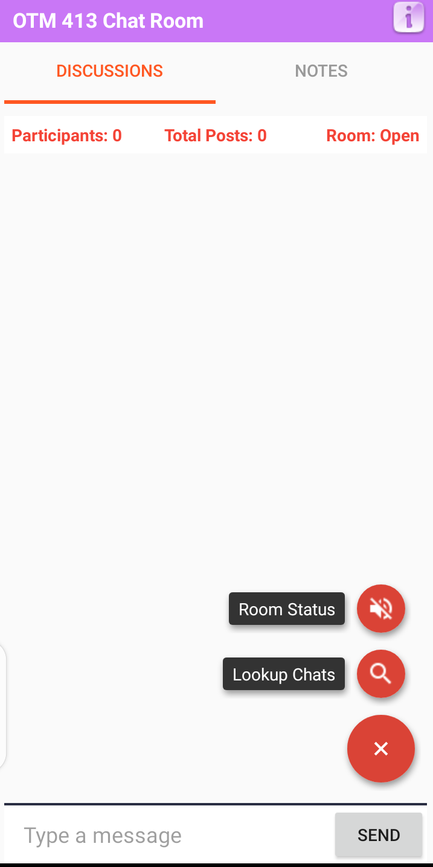
Menu List: Registered Courses on Dashboard (Chat room/Discussion)
To change chat room status
(Muted/Open)
4
To search for keywords fom precious chat/discussion
To minimize function

Slide 20
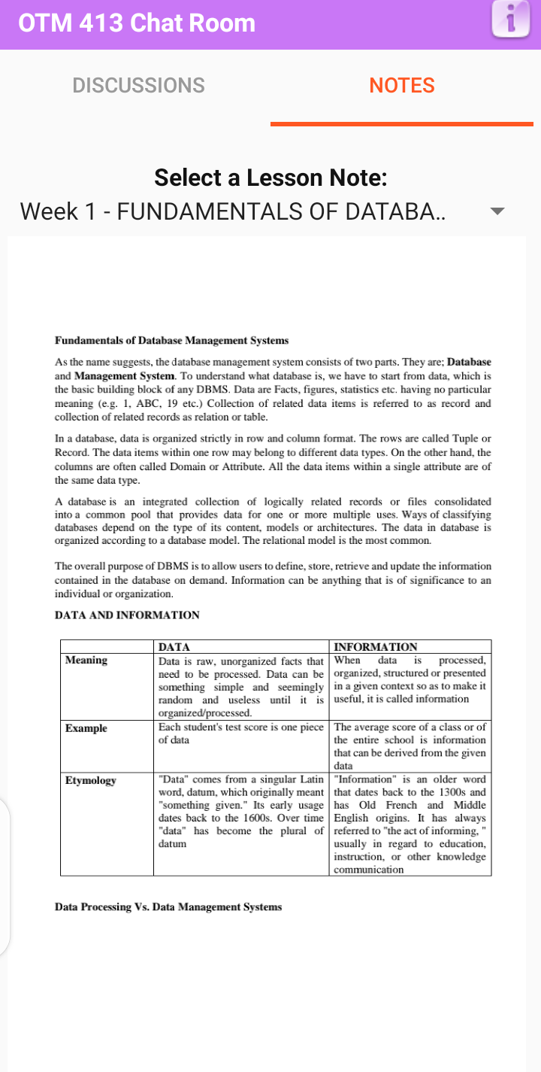
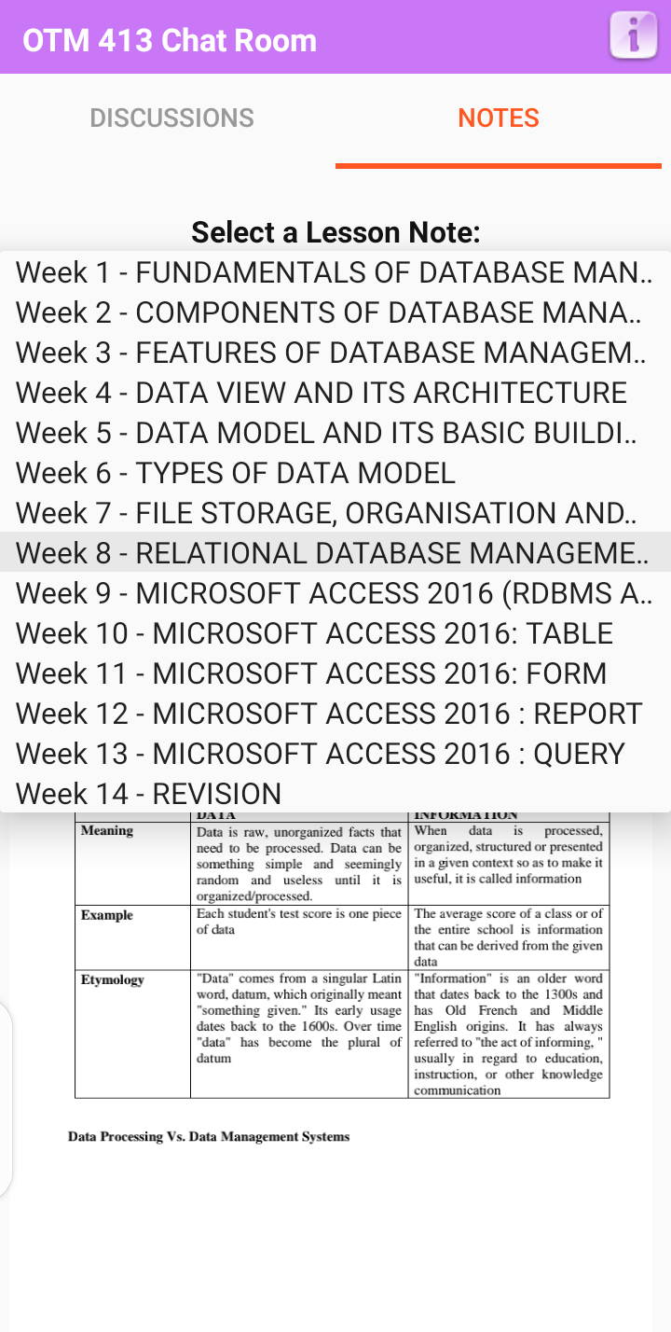
Menu List: Registered Courses on Dashboard (Chat room/Notes)
4
Week 1 – lesson note displayed
List of lesson notes from course outlines

Slide 21
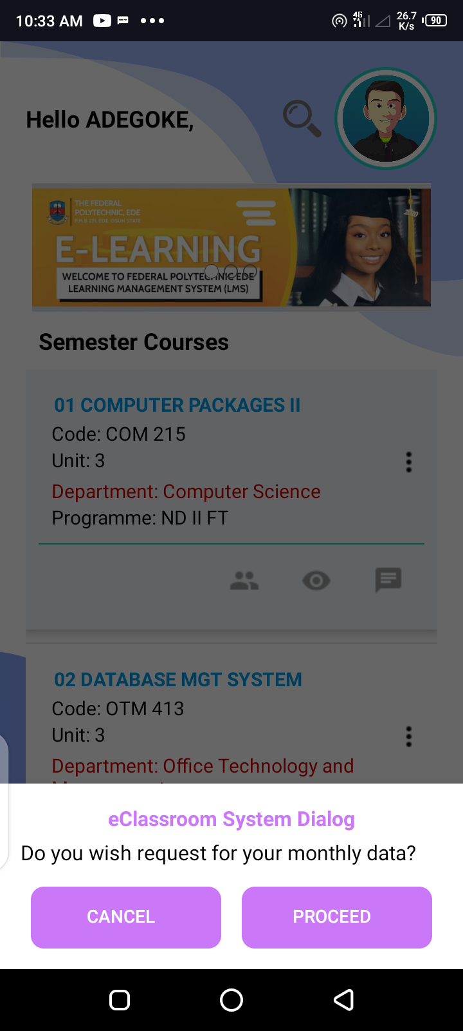
Menu List: Monthly Data Request
This function allows you to request for your monthly data.

Slide 22
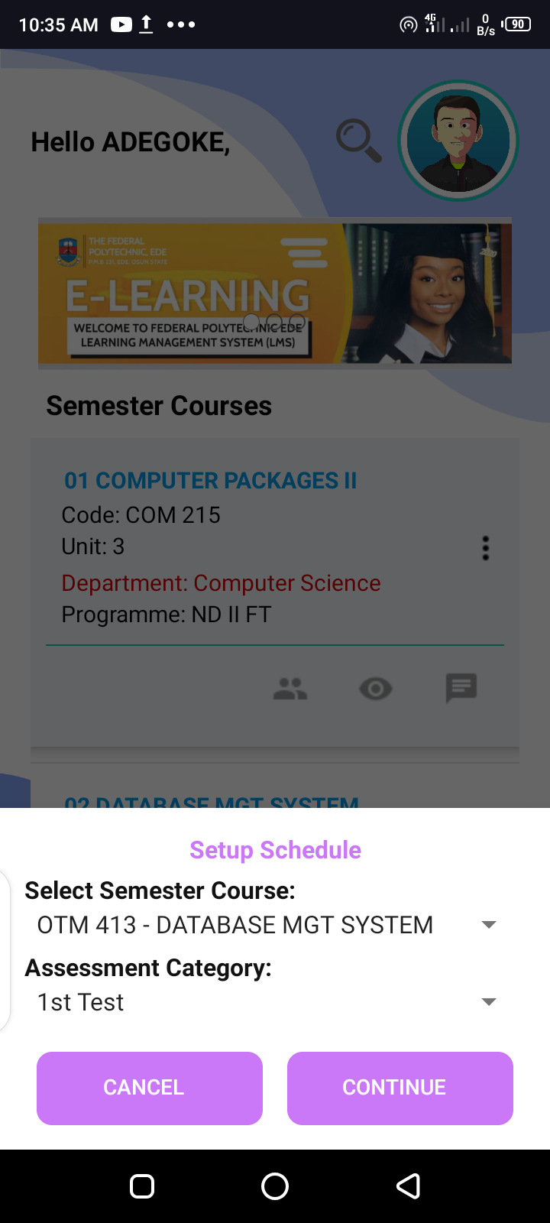
Menu List: Setup Schedule

Slide 23
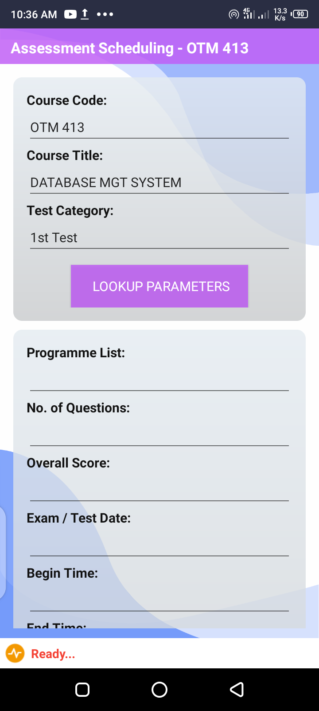
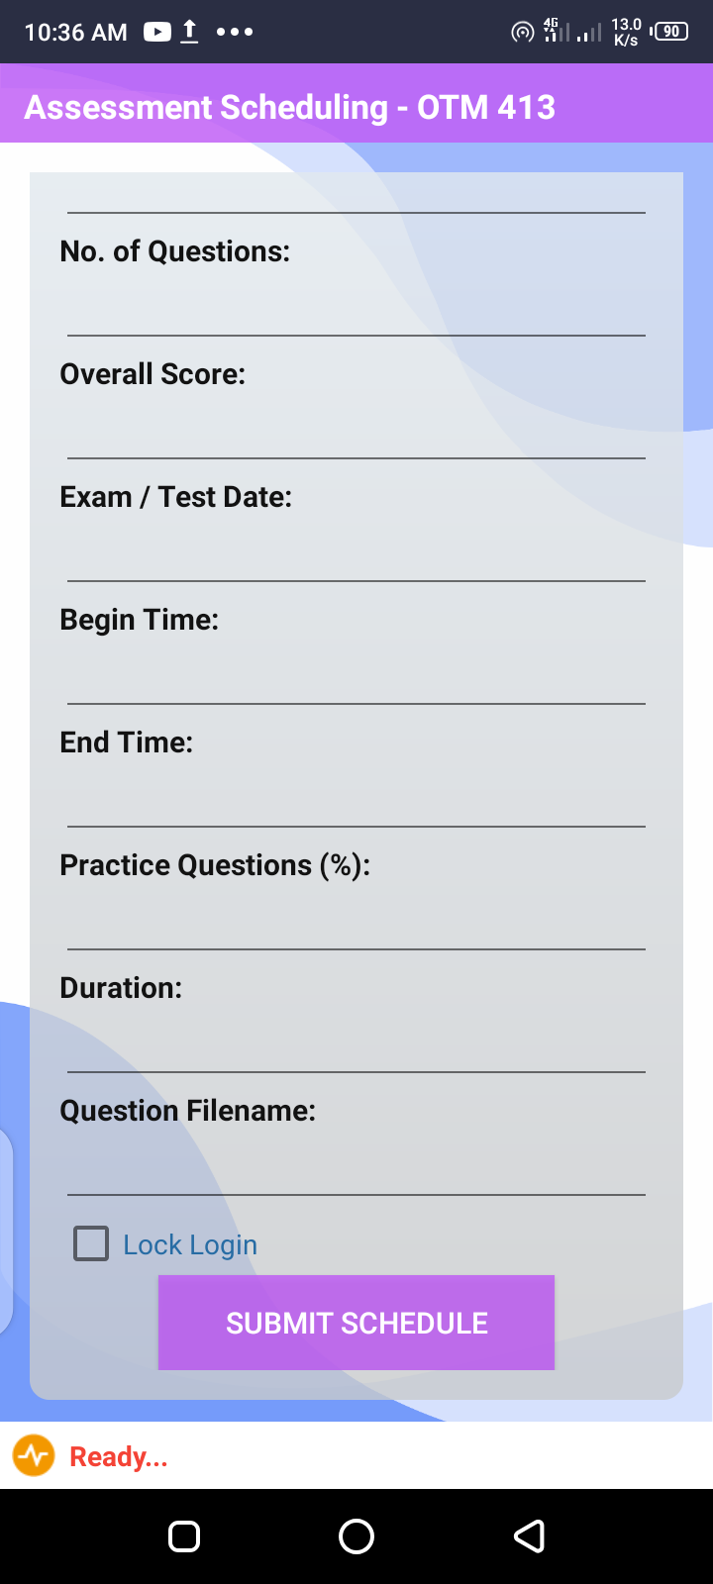
Menu List: Setup Schedule… Contd.
Enter list of classes to be scheduled for assessment e.g
Specify starting time
Specify ending time
Number of question to be answered
Specify % of practice question allowed from bank
Specify time allowed for assessment
Overall/ Total scores
This is optional
Assessment date and time to be selected

Slide 24
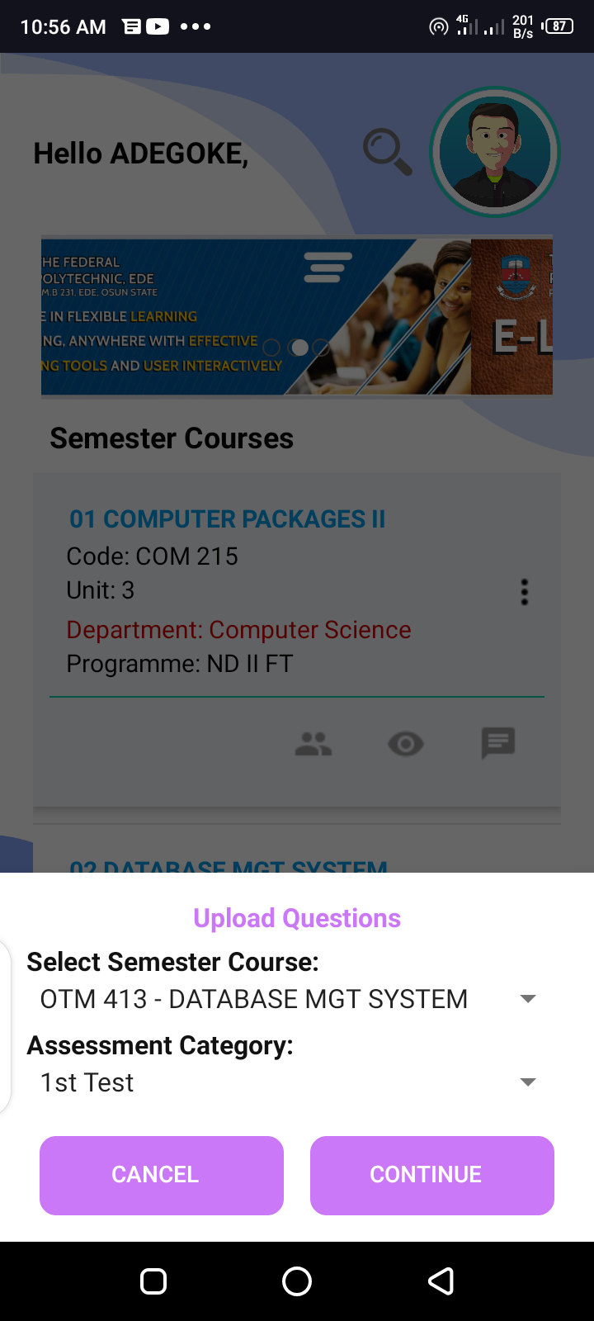
Menu List: Upload Question
Continue to assess file on your smart device.

Slide 25
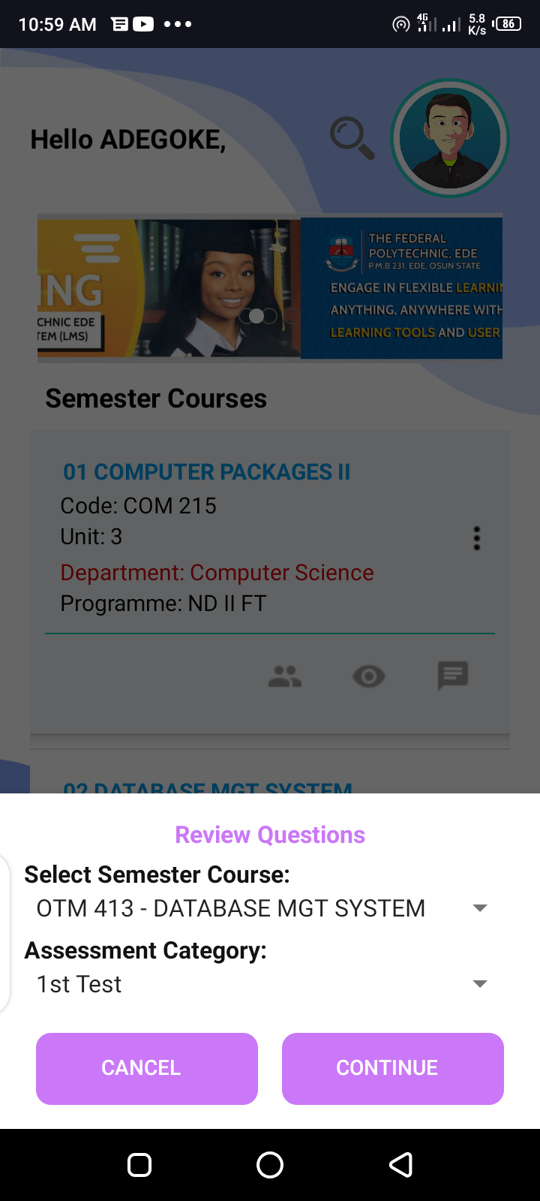
Menu List: Review Question
Click continue to review all uploaded questions

Slide 26
Menu List: Download Template
These function allows you to download accepted templates for setting course outline and CBT questions.

Slide 27
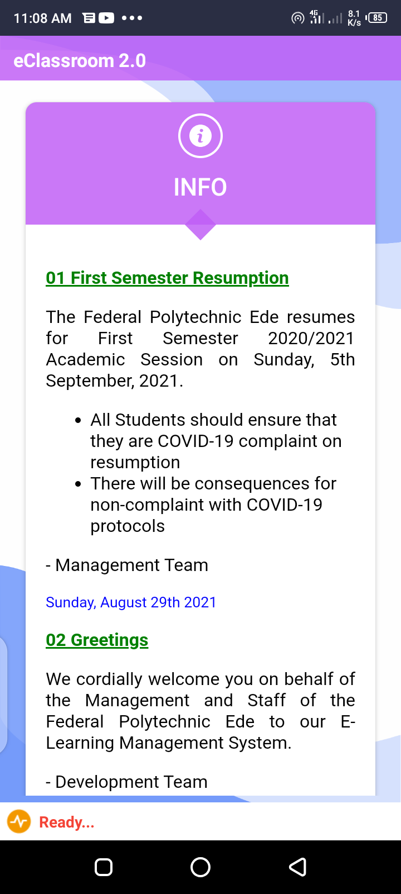
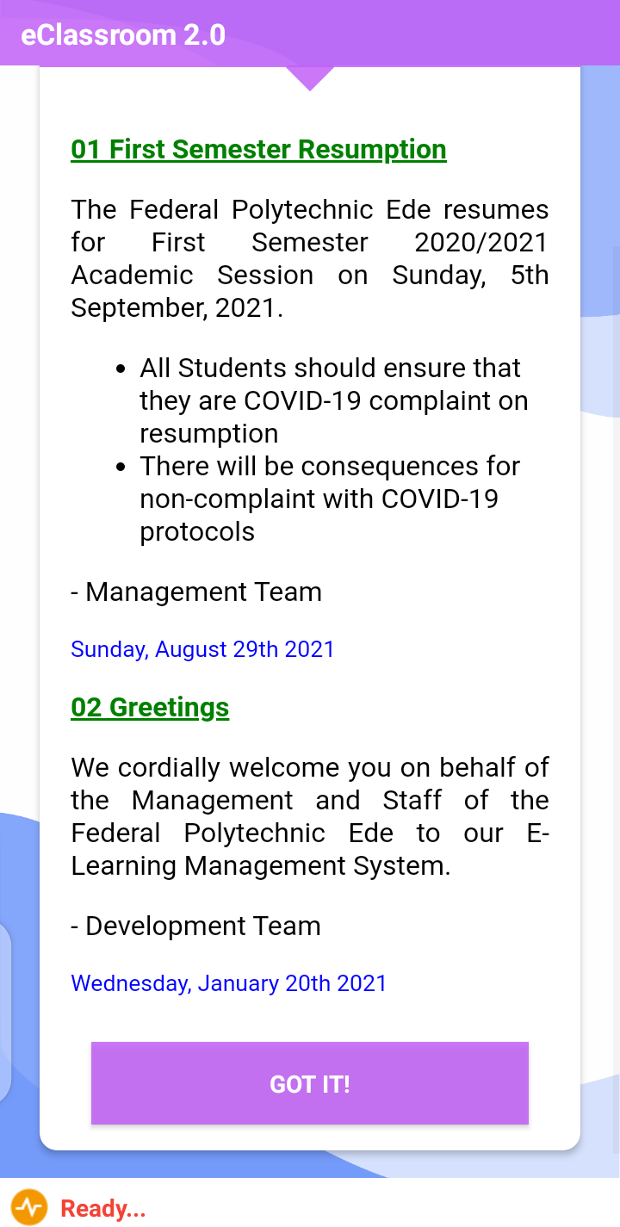
Menu List: Notification
This is a digital notification board for information dissemination

Slide 28
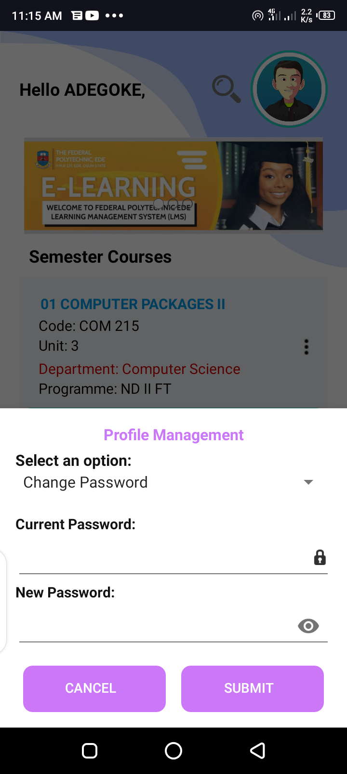
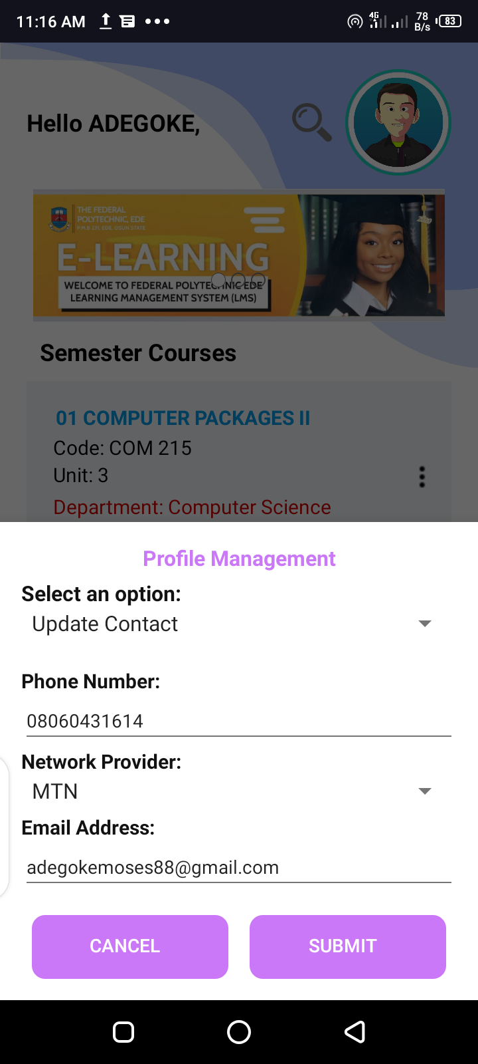
Menu List: My Profile
This function allows you manage your profile (i.e Change password and update contact)

Slide 29
Menu List: Share
Allow user to share download link with students and colleagues

Slide 30
Thank you!

